Slide 1
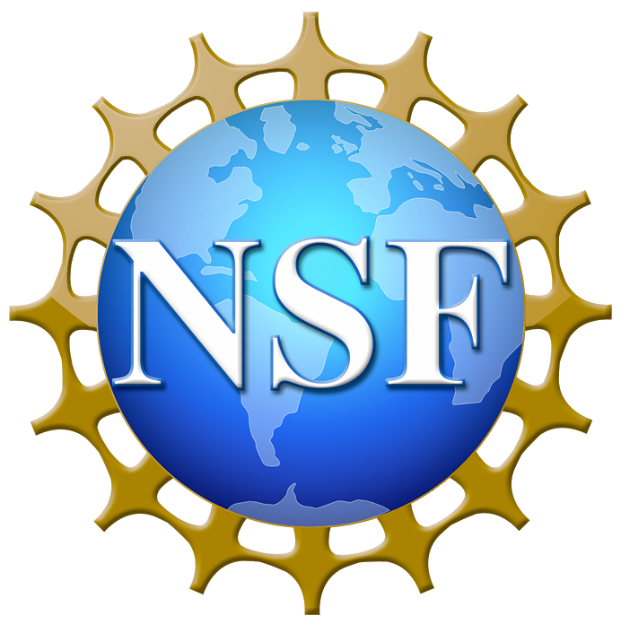
Project # 8 - Internet of Hospital Things (IoHT): Communicating to Facilitate Healing REU student: Stefanie Mutter Graduate mentors: Myungho Lee, Kangsoo Kim Faculty mentor(s): Dr. Gerd Bruder, Dr. Greg Welch
Week 3 (May 28 – June 4, 2018)
Accomplishments:
Determined method of creating realistic virtual agents
Unity Multipurpose Avatar (UMA) character generation package
UMA gives the option to create high-fidelity characters that we need for the research project (as well as other projects) at a lower cost and time than giving the task to an animator to complete from scratch for $900
Became familiar with Autodesk Maya & process of animating characters
Problem & Solutions:
Clothes/appearance decisions
Need to figure out what clothes and appearance the virtual agents will have – gender neutral qualities?
Will the characters’ clothes be skin-tight, or be layered on top of their skeleton texture?
Need to make iRIS account but still no NID
Plans for next week:
Hopefully complete iRIS account for IRB modification
Begin making virtual agents/modifying appearances
Outline research study methods
NSF REU Research Experience on Internet of Things 2018

Slide 2
https://www.youtube.com/watch?v=hAP2rGECadQ
Unlike Katie, whose clothes are part of her textures, Michael has a layer of textures on top of the ”body” textures that are clothes. However, his shirt is made so it cannot be worn without the jacket – thus, if we wanted to change Michael’s clothes, we would have to either extend the shirt or create a completely new shirt with new textures.

