Slide 1
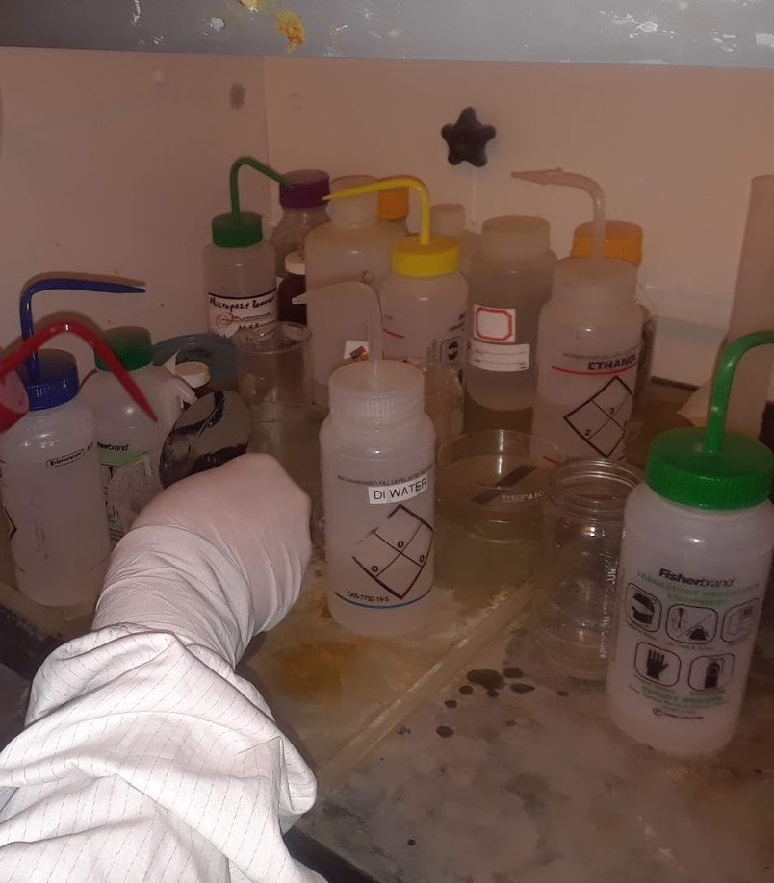
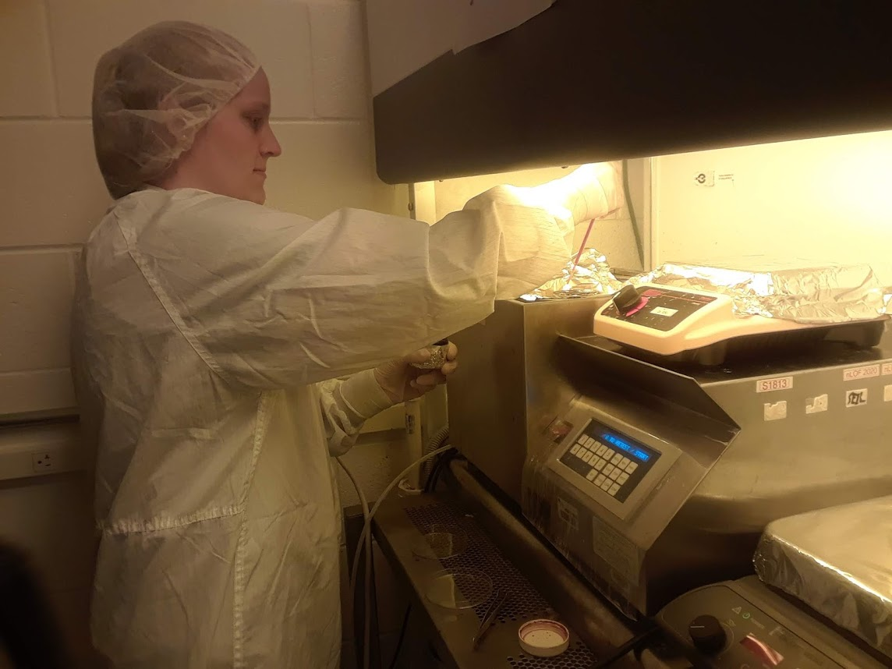
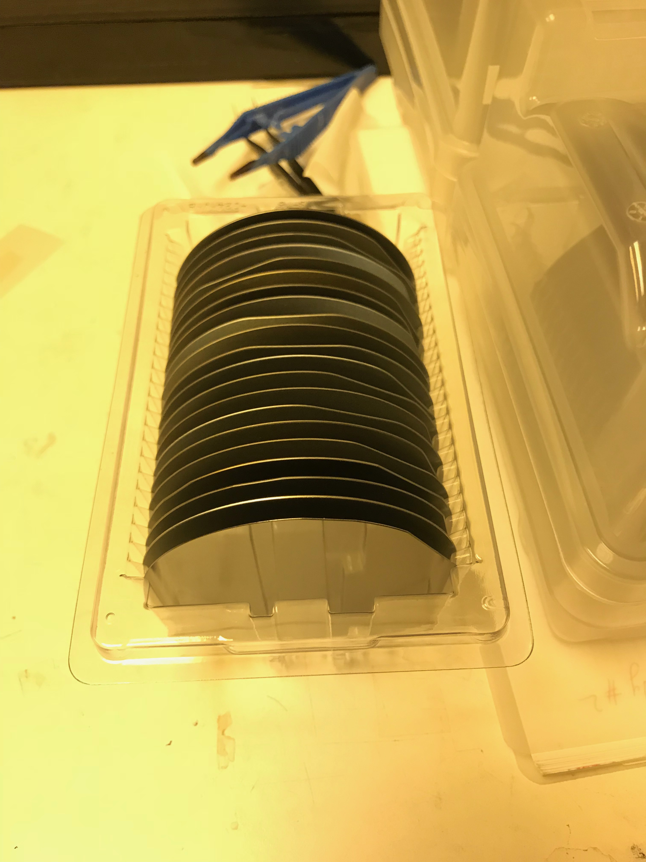
Project #3: Low Cost, Ultralow Power Sensor Design and Fabrication for IoT REU student: Mary Broyhill Graduate mentors: Pawan Pathak Faculty mentor(s): Hyoung Jin Cho
Week 4 (June 4– June 8, 2018)
Accomplishments:
Worked in the clean room and use photolithography to transfer an image on a silicon wafer.
Photolithography is a type of microfabrication that uses UV light to transfer a pattern or image onto a substrate.
Spin coating: Wafer was covered with photoresist and then spun for 30 seconds at 3000 rpm
Start with a silicon wafer
Clean the wafer with acetone, methanol, and DI water
NSF REU Research Experience on Internet of Things 2018

Slide 2
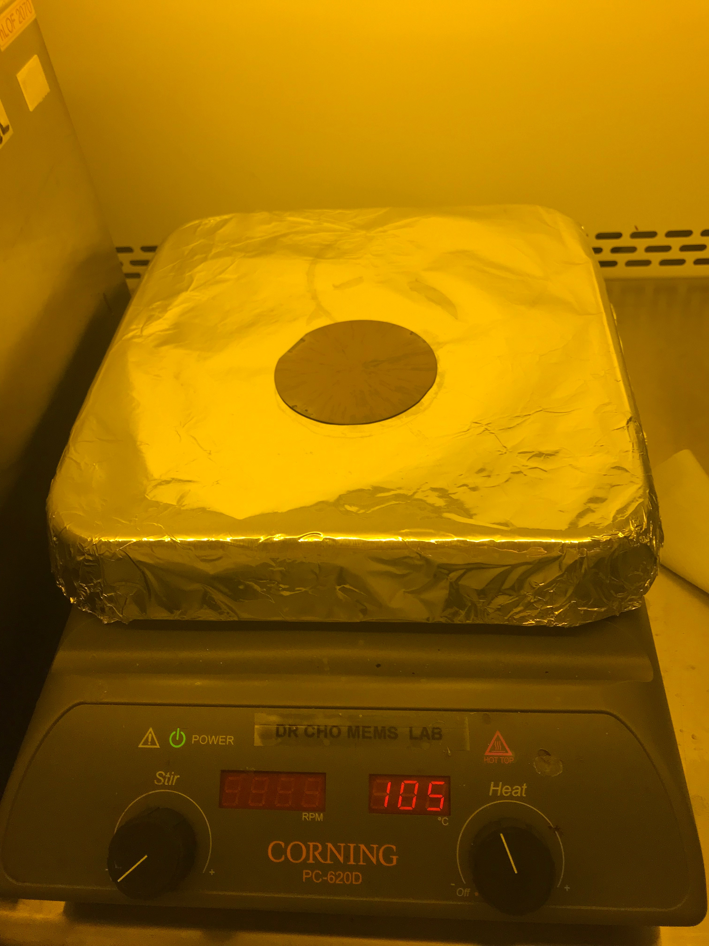
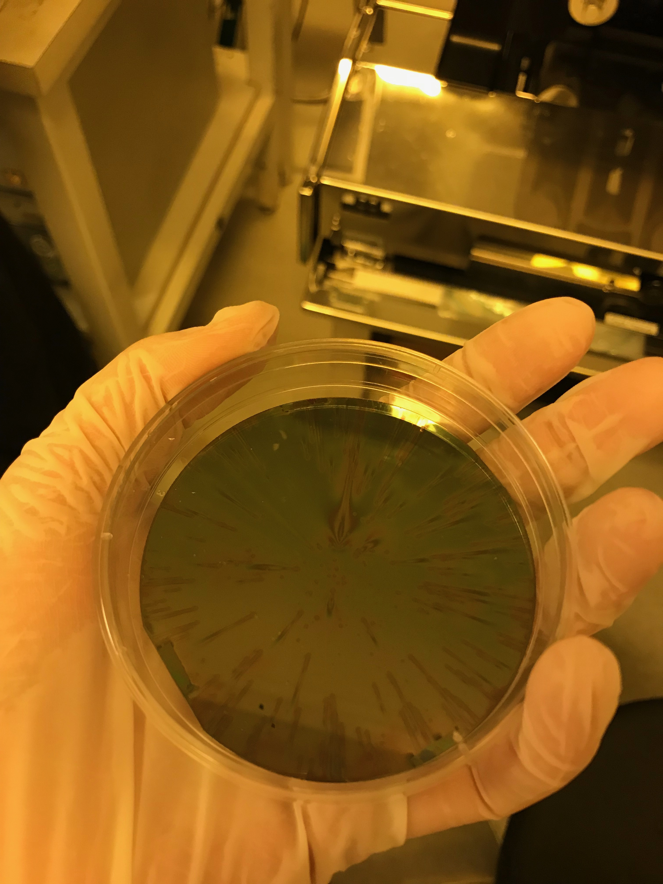
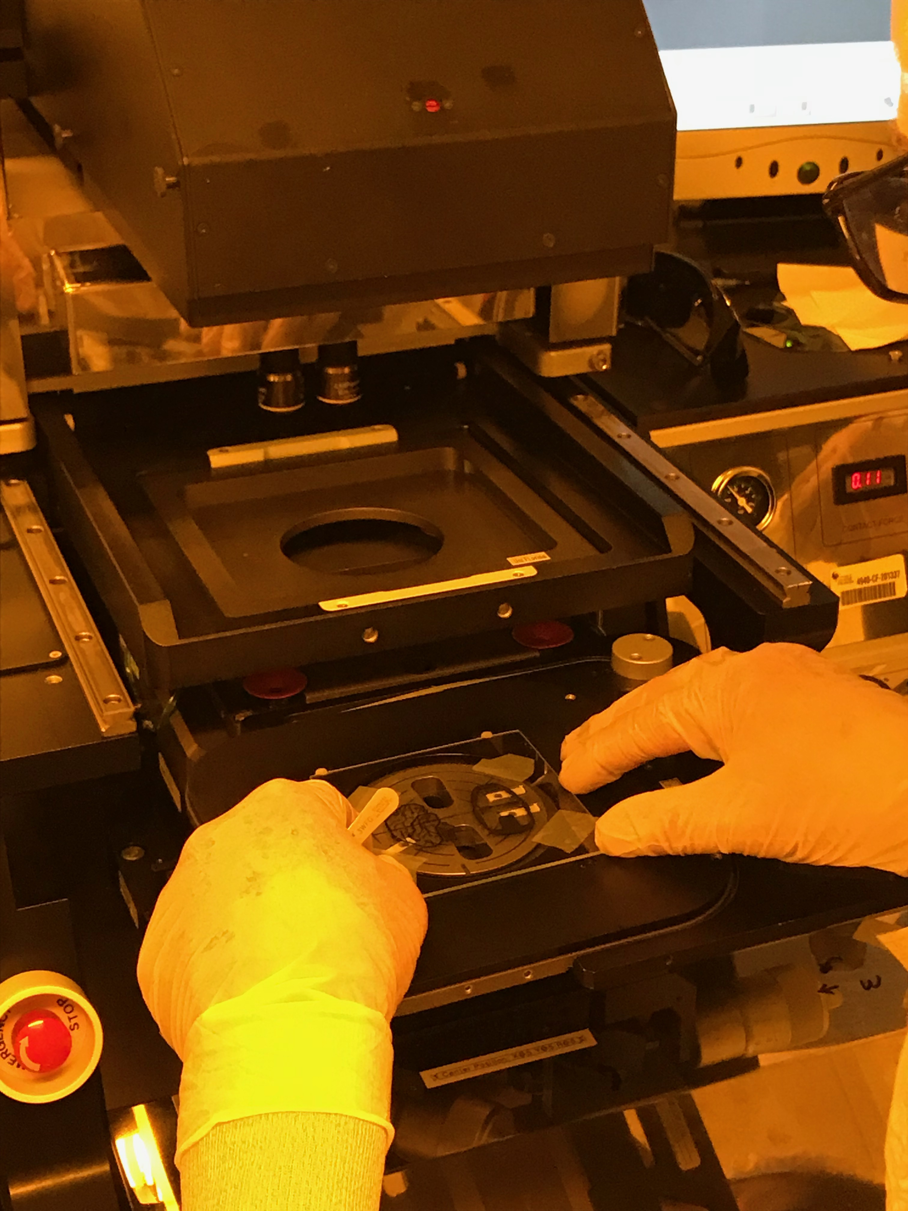
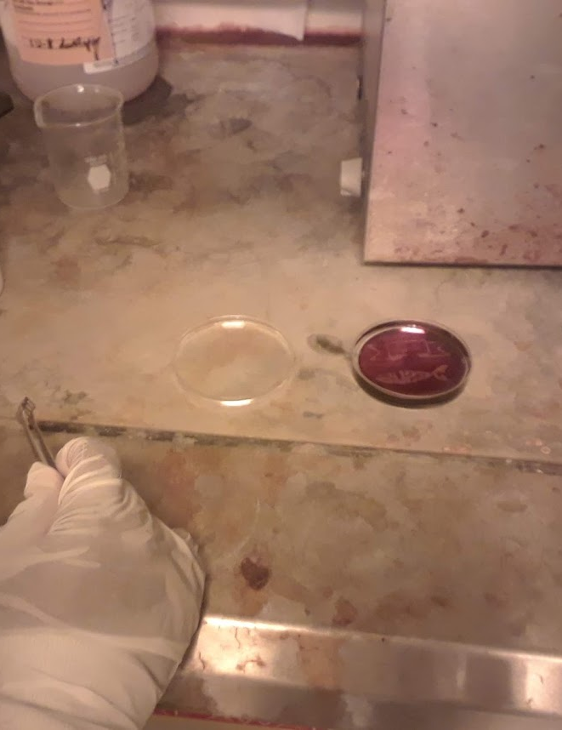
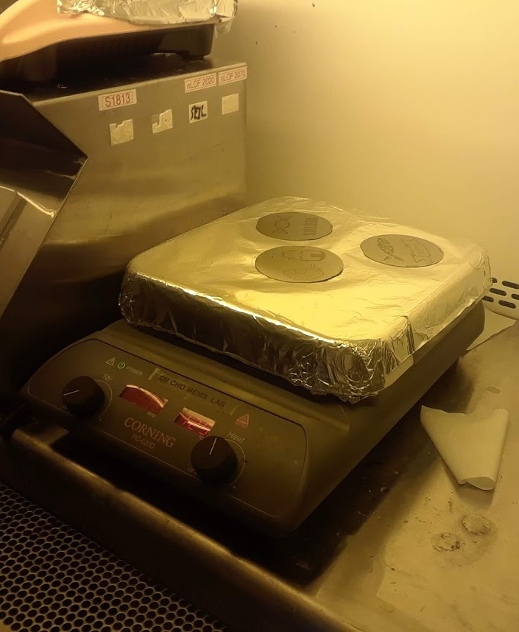
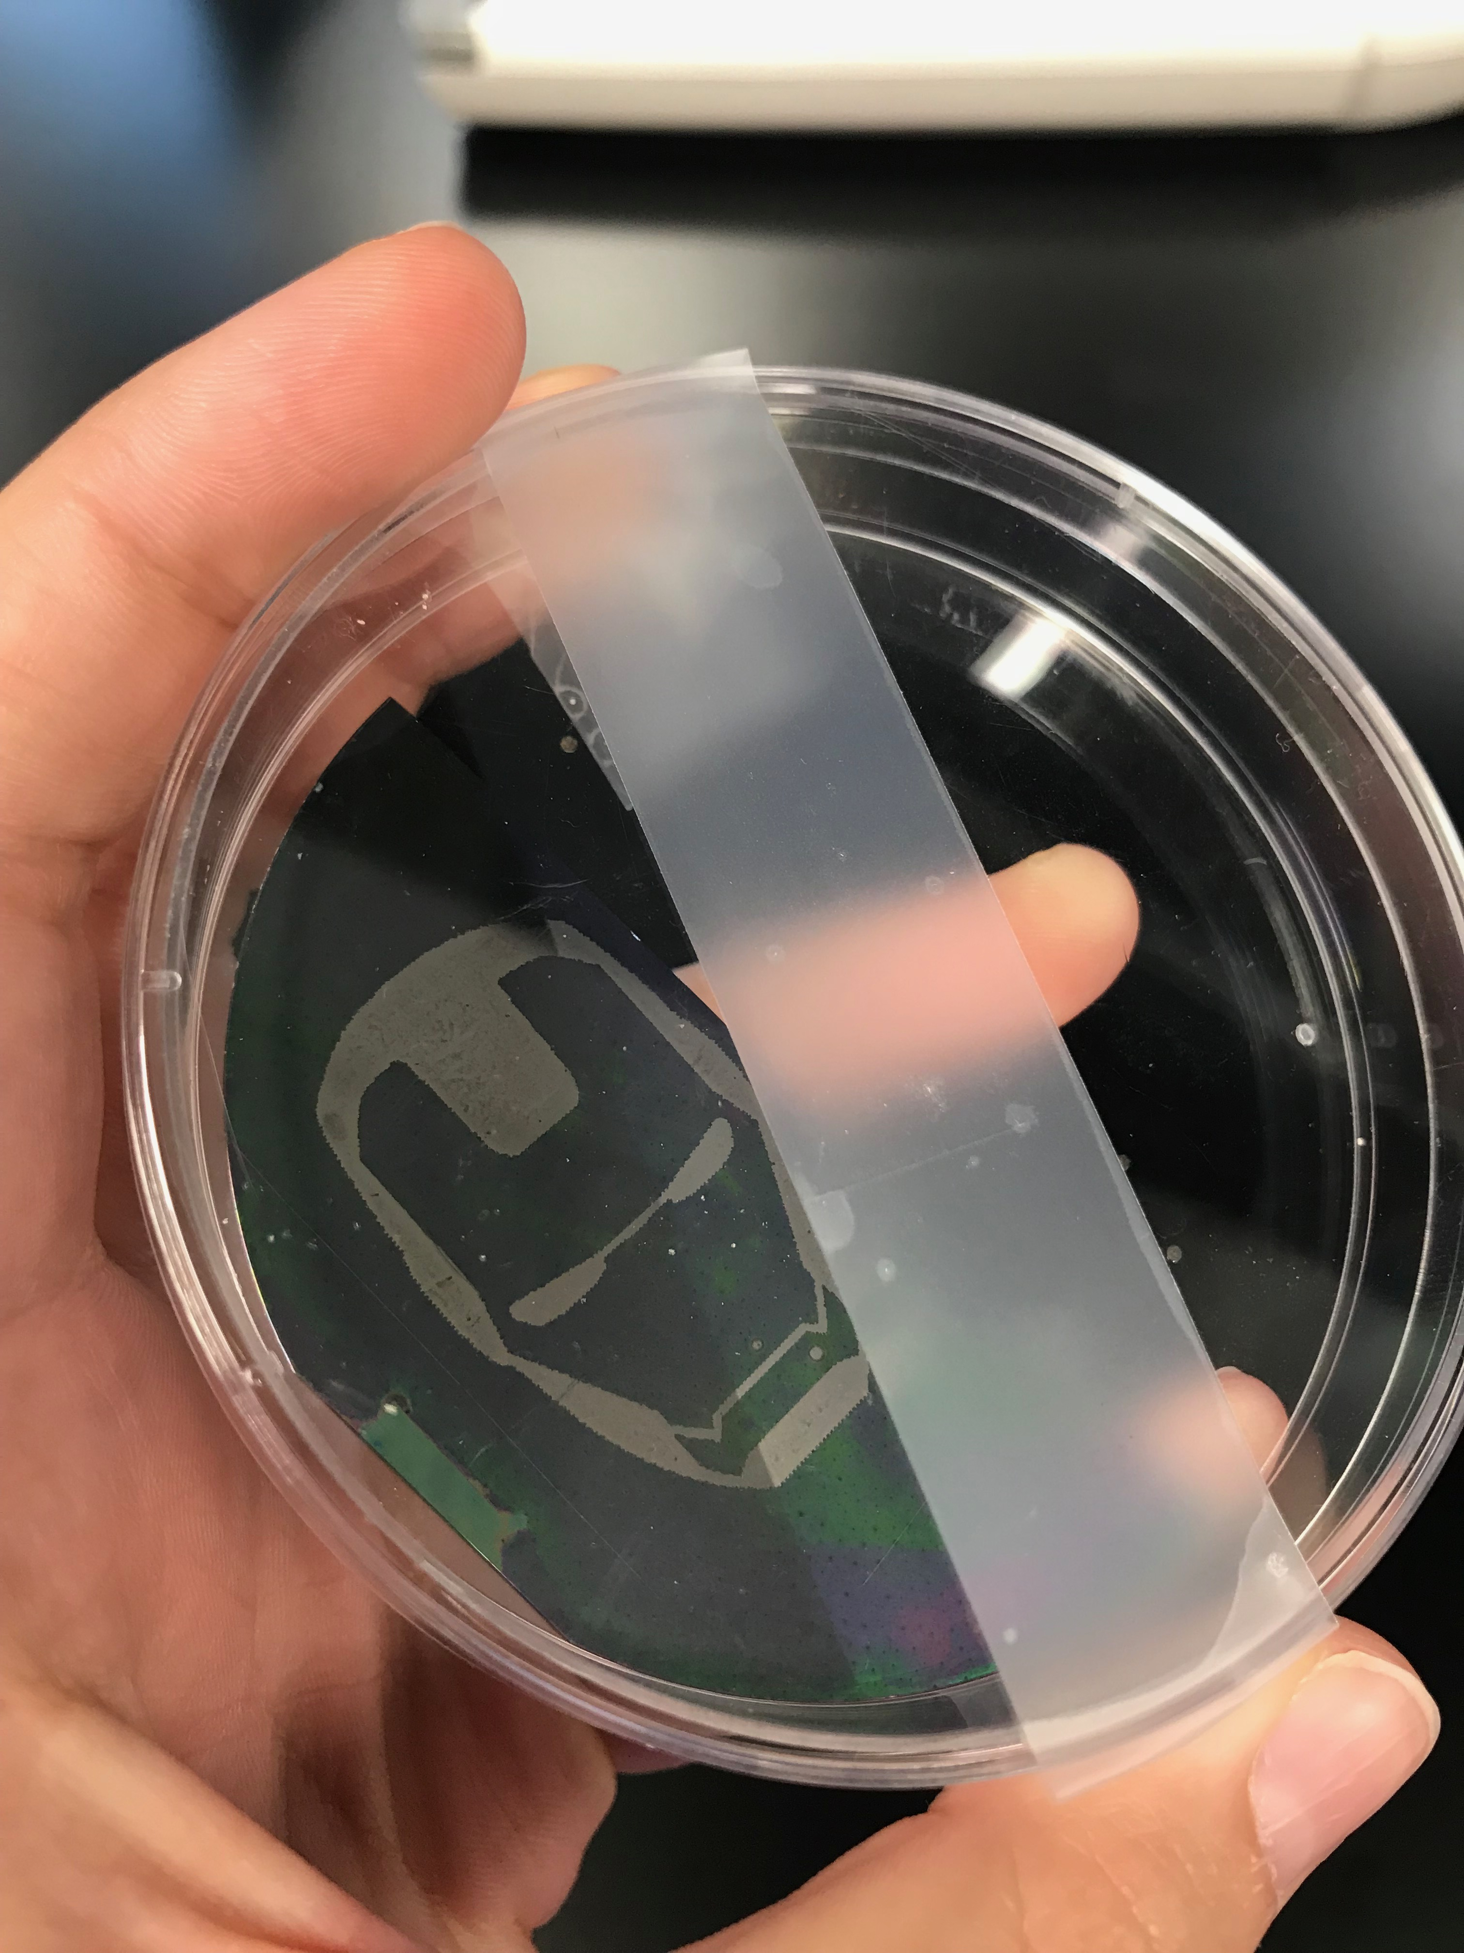
Soft bake for 3 minutes at 105 degrees.
Exposed to UV light for 8.8 seconds.
Place the wafer in a special solution called developer for 2 minutes.
Hot bake for 12 minutes at 125 degrees.
Etching: removes the uppermost layer of the substrate that is not protected by the photoresist. And this is the final product.
NSF REU Research Experience on Internet of Things 2018

Slide 3
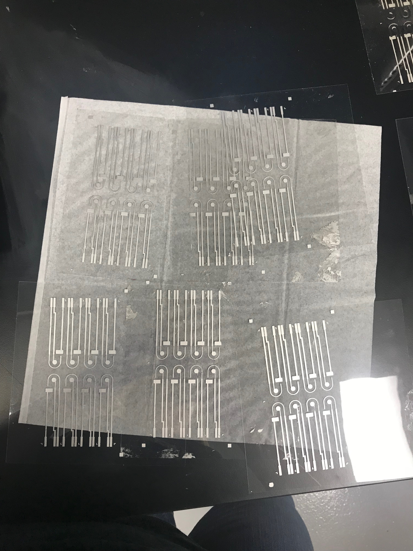
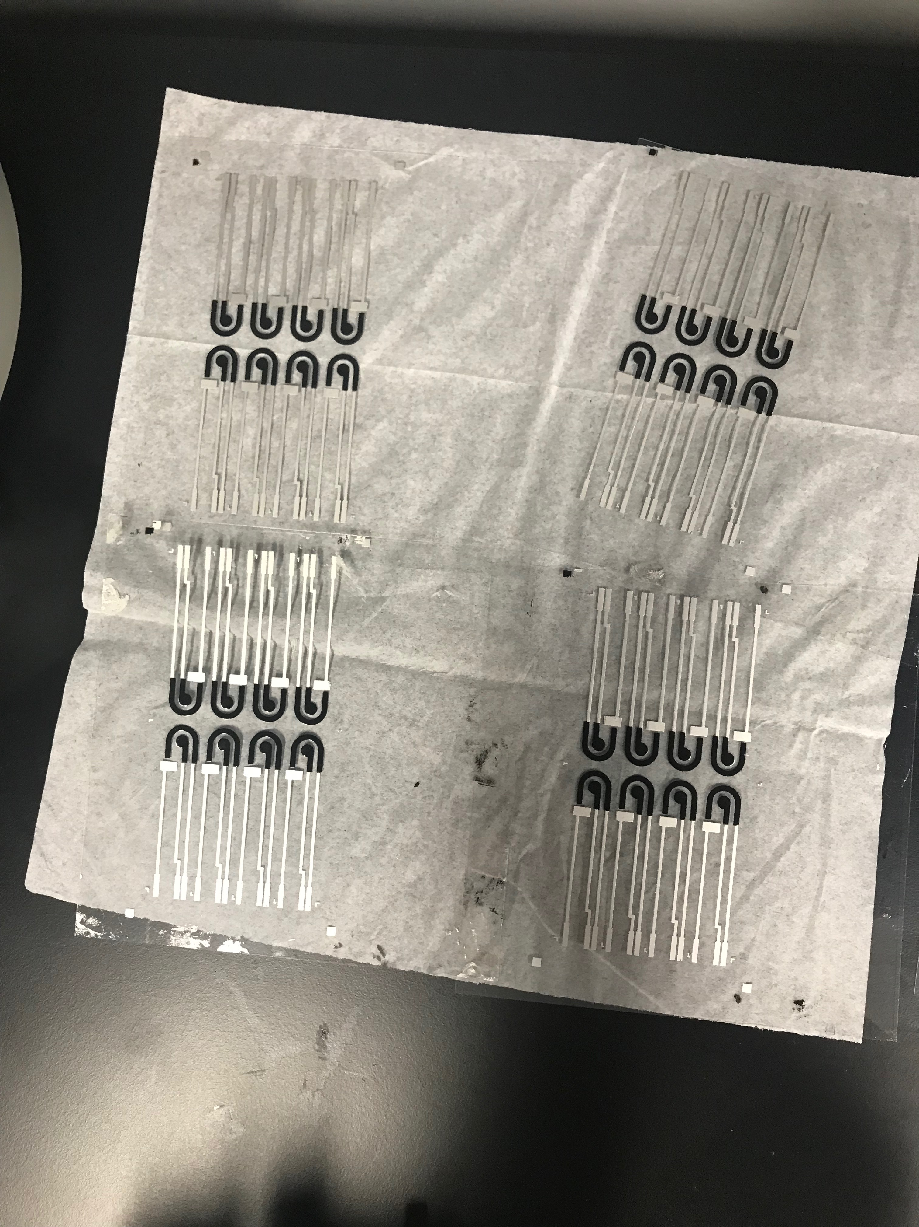
Accomplishments:
Screen printed the first and second layer of the disposable sensors.
Problems & Solutions:
No problems this week.
Plans for next week:
Continue screen printing sensors.
NSF REU Research Experience on Internet of Things 2018

