Slide 1
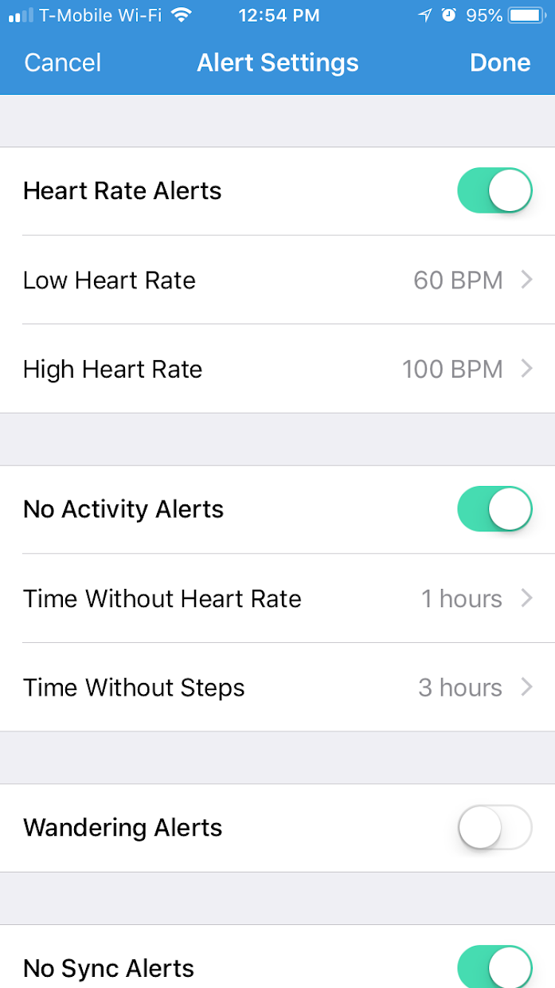
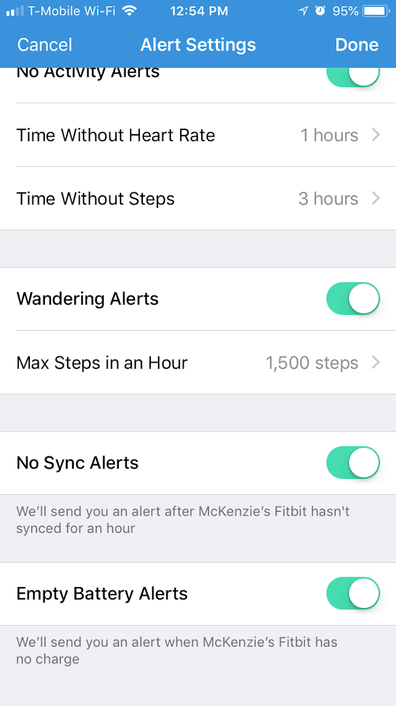
Project 9: Investigating User Benefits and Risks Associated with IoT use REU Student: Kaley Brindisi Graduate mentor: Karla Badillo-Urquiola Faculty Mentor(s): Dr. Wisniewski
Week 5 (June 11 – June 18 2018)
Accomplishments:
UI accomplishments: Created persistent bar at the top of the dashboard (displays total number of alerts for the day & links to alert history page), created phone call icon to allow caregiver to contact caregivee, continued implementing/finalizing alerts- added new alert types, worked on alert history page and created new icons
4 New Alerts in Settings Screen
NSF REU Research Experience on Internet of Things 2018

Slide 2
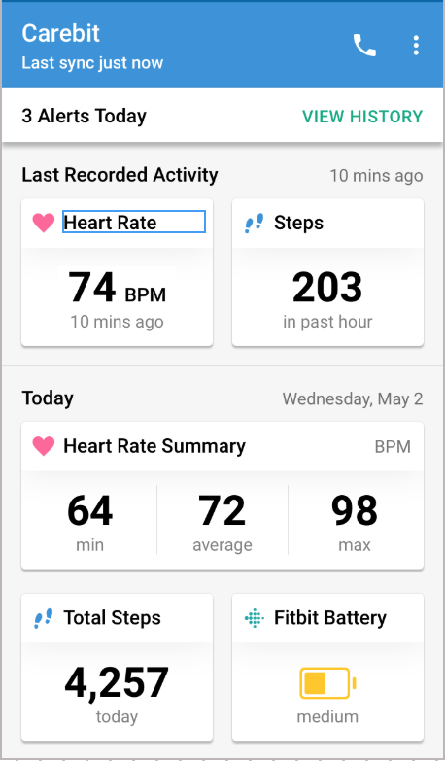
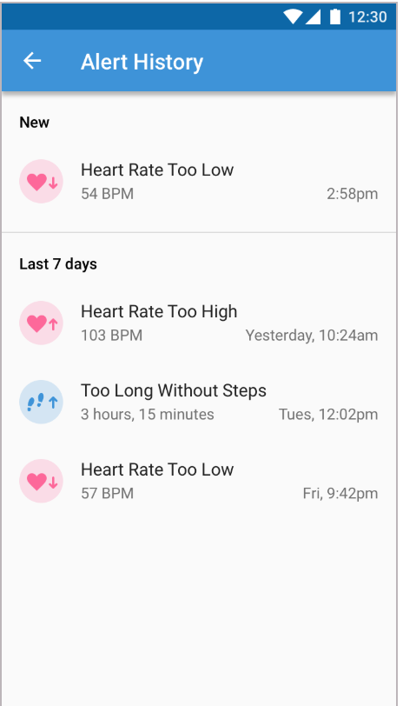
Project 9: Investigating User Benefits and Risks Associated with IoT use REU Student: Kaley Brindisi Graduate mentor: Karla Badillo-Urquiola Faculty Mentor(s): Dr. Wisniewski
Call Cargivee
Persistent Bar
New Dashboard
Alert History Screen
New Icons
NSF REU Research Experience on Internet of Things 2018

Slide 3
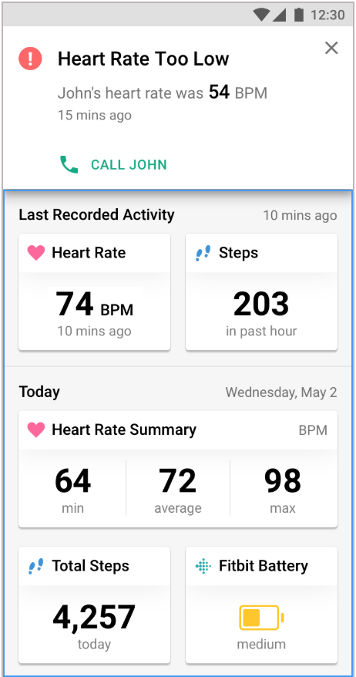
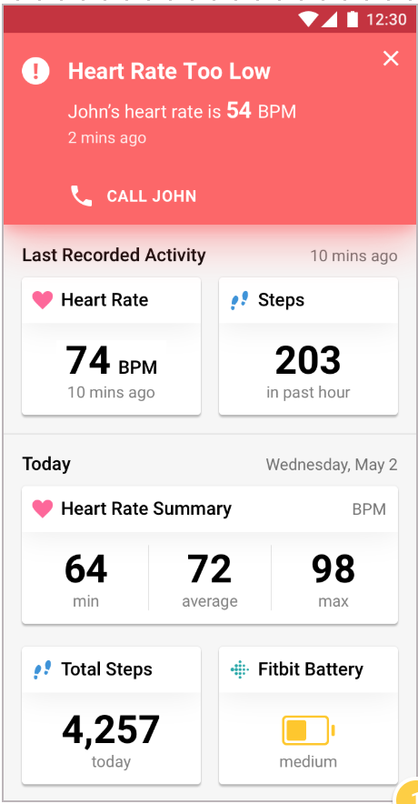
Project 9: Investigating User Benefits and Risks Associated with IoT use REU Student: Kaley Brindisi Graduate mentor: Karla Badillo-Urquiola Faculty Mentor(s): Dr. Wisniewski
White means
past alert
Red means current alert
Dashboard when an alert is first presented
NSF REU Research Experience on Internet of Things 2018

Slide 4
Project 9: Investigating User Benefits and Risks Associated with IoT use REU Student: Kaley Brindisi Graduate mentor: Karla Badillo-Urquiola Faculty Mentor(s): Dr. Wisniewski
Week 5 (June 11 – June 18 2018)
Accomplishments:
iOS Accomplishments- fixed total steps on dashboard (steps intraday was reporting a different number than total steps in Fitbit API), made refresh smoother transition
Android Accomplishments- fixed error that caused app to crash on certain devices and not others, updated the alert settings to look the same as iOS, created app icon
Worked on midterm report
Called 30 people and emailed 40 people to participate in user study
Problems & Solutions:
Not many people agreeing to the user study- need to recruit more people
Plans for next week:
Recruit more people- look into different places to contact for participants
Finalize application for user study
Finish midterm report
NSF REU Research Experience on Internet of Things 2018

