Slide 1
Project 9: Investigating User Benefits and Risks Associated with IoT use REU Student: Kaley Brindisi Graduate mentor: Karla Badillo-Urquiola Faculty Mentor(s): Dr. Wisniewski
Week 3 (May 28- June 4 2018)
Accomplishments:
Called Apple developers to help us get the iOS app onto everyone’s phones for testing purposes
iOS- fixed the dashboard, worked on what is displayed when there is no data taken (ex: the user did not walk, or the user was not wearing their Fitbit, or the Bluetooth is off so the Fitbit data cannot sync to the phone), fixed an error, added empty battery icon if the Fitbit was dead, got the app to fully log out of Fitbit when you hit sign out
Android- created background screens for the login prompts and screens for choosing ranges for heart rate and time, fixed the dashboard
Problems & Solutions:
No NID account so I cannot obtain an iRIS account and cannot get access to user study site
Android phone was not charging when it was plugged in so I could not test the Android app- got a new Android
Need to develop a way to chose a specific phone number for the caregivee (if there are multiple phone numbers under one name in the contacts list)
Plans for next week:
Work on displaying alerts for both applications
Android- work on the log out process, fix reoccurring bugs, fix dashboard that is displayed when no data is taken
Recruit participants for the user study
NSF REU Research Experience on Internet of Things 2018

Slide 2
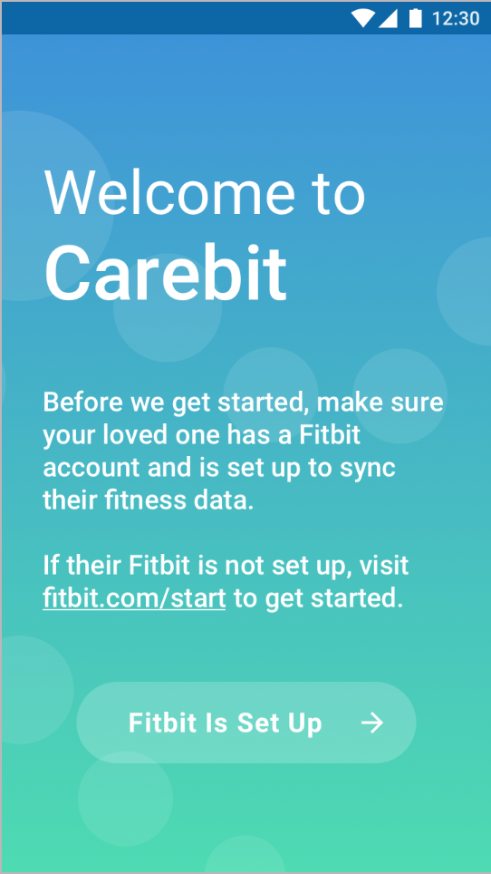
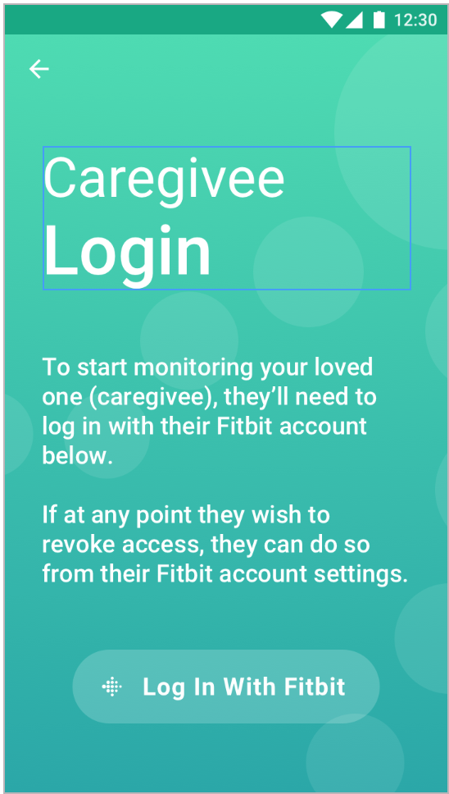
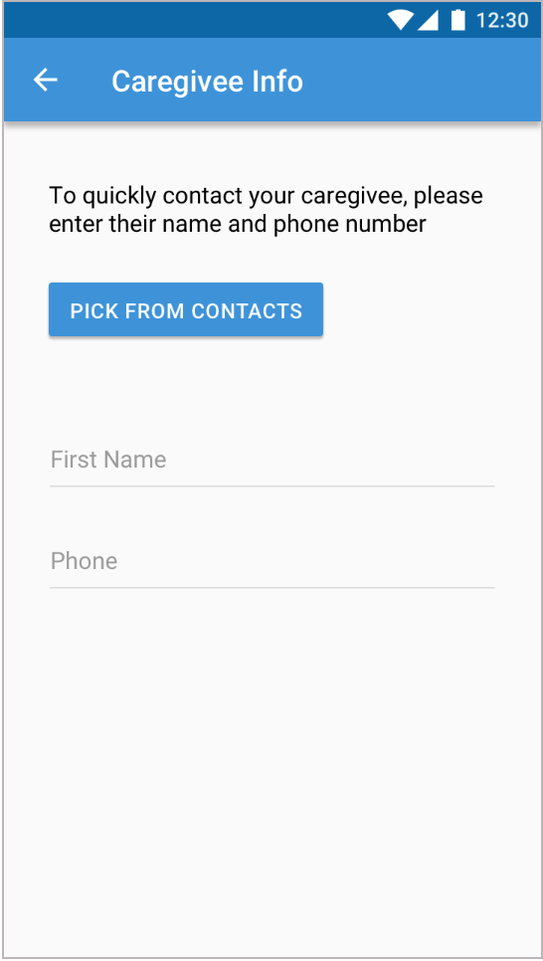
Project 9: Investigating User Benefits and Risks Associated with IoT use REU Student: Kaley Brindisi Graduate mentor: Karla Badillo-Urquiola Faculty Mentor(s): Dr. Wisniewski
Week 3 (May 28- June 4 2018)
NSF REU Research Experience on Internet of Things 2018

Slide 3
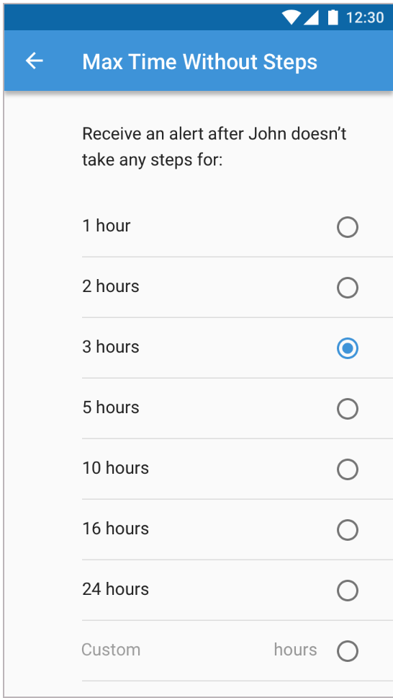
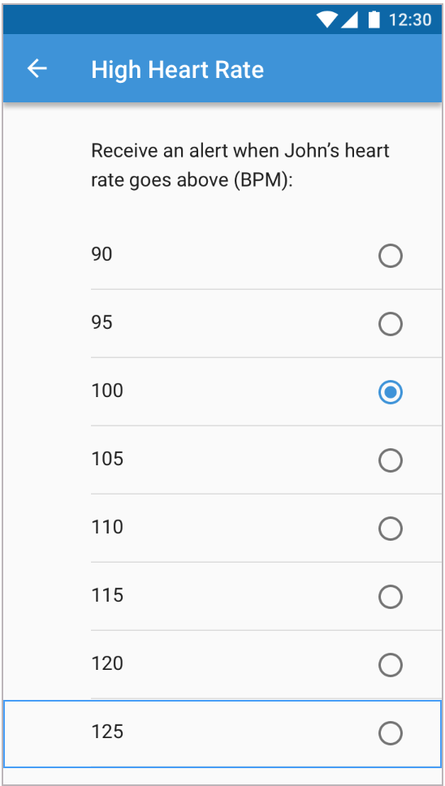
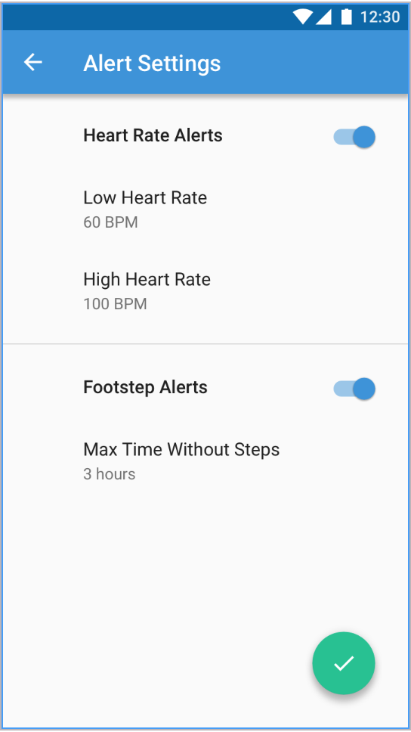
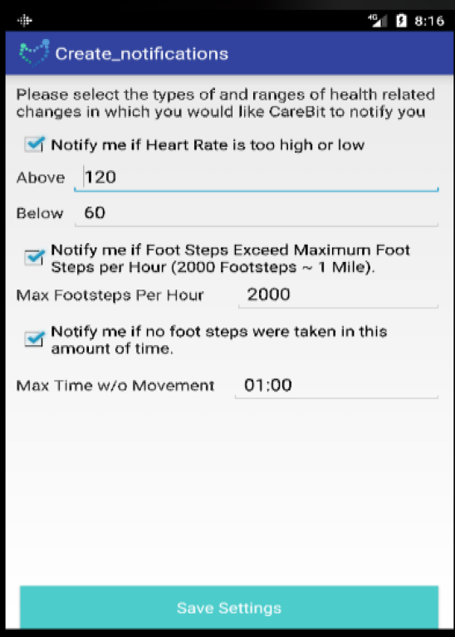
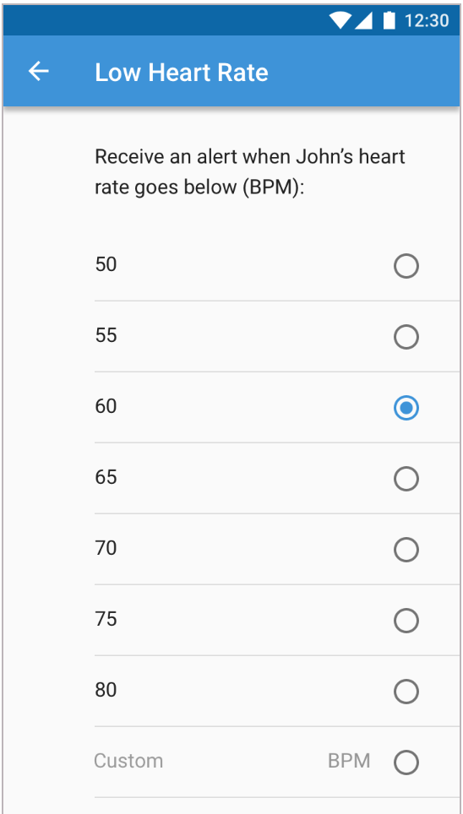
Project 9: Investigating User Benefits and Risks Associated with IoT use REU Student: Kaley Brindisi Graduate mentor: Karla Badillo-Urquiola Faculty Mentor(s): Dr. Wisniewski
Week 3 (May 28- June 4 2018)
Old Notification Page
New notifications pages
NSF REU Research Experience on Internet of Things 2018

Slide 4
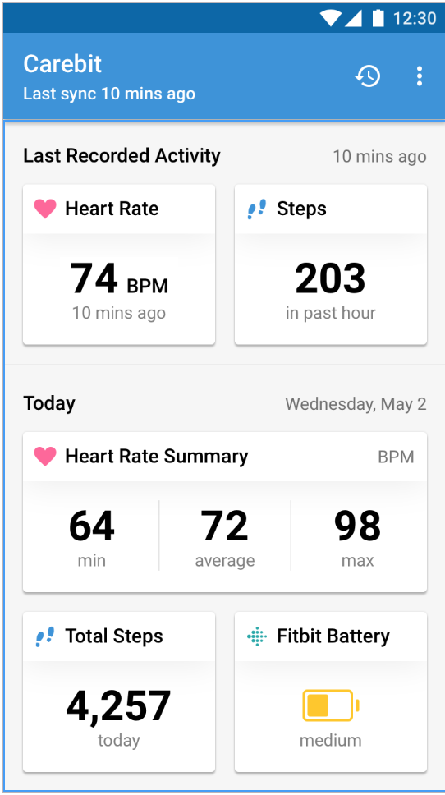
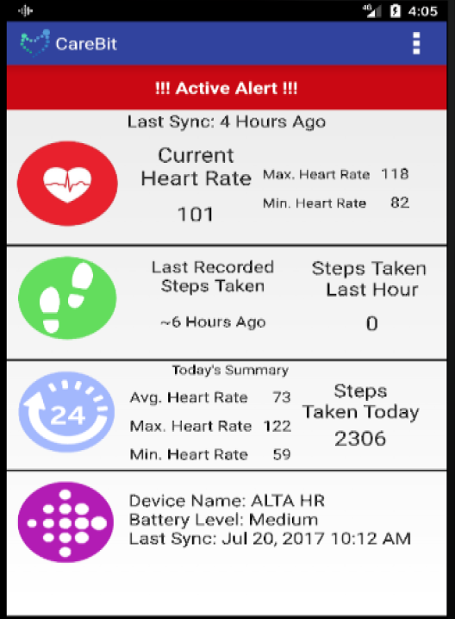
Project 9: Investigating User Benefits and Risks Associated with IoT use REU Student: Kaley Brindisi Graduate mentor: Karla Badillo-Urquiola Faculty Mentor(s): Dr. Wisniewski
Week 3 (May 28- June 4 2018)
Old dashboard
Updated Dashboard
NSF REU Research Experience on Internet of Things 2018

