Slide 1
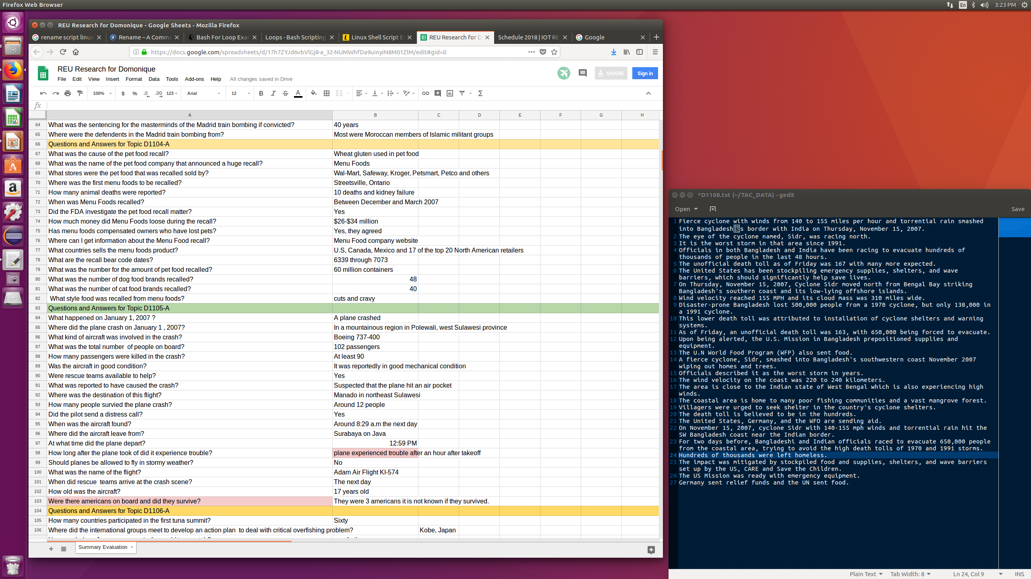
Project # 5: Generating Privacy and Security Threat Summary for Internet of Things
REU student: Domonique Cox
Graduate mentors: Kaiqiang Song
Faculty mentor(s): Dr.Fei Liu
Week 7 ( June 25 – July 2, 2018)
Accomplishments:
Continued to annotate data.
NSF REU Research Experience on Internet of Things 2018

Slide 2
Project # 5: Generating Privacy and Security Threat Summary for Internet of Things
REU student: Domonique Cox
Graduate mentors: Kaiqiang Song
Faculty mentor(s): Dr.Fei Liu
Week 7 ( June 25 – July 2, 2018)
Problem & Solutions
I did not encounter any major problems this week.
Plans for next week:
Meet with mentor and discuss other tasks.
NSF REU Research Experience on Internet of Things 2018

