Slide 1
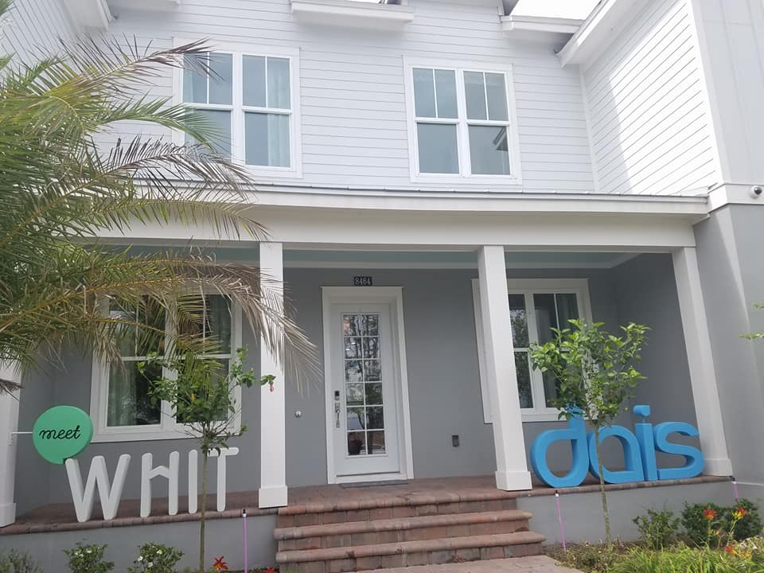
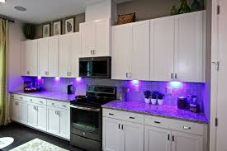
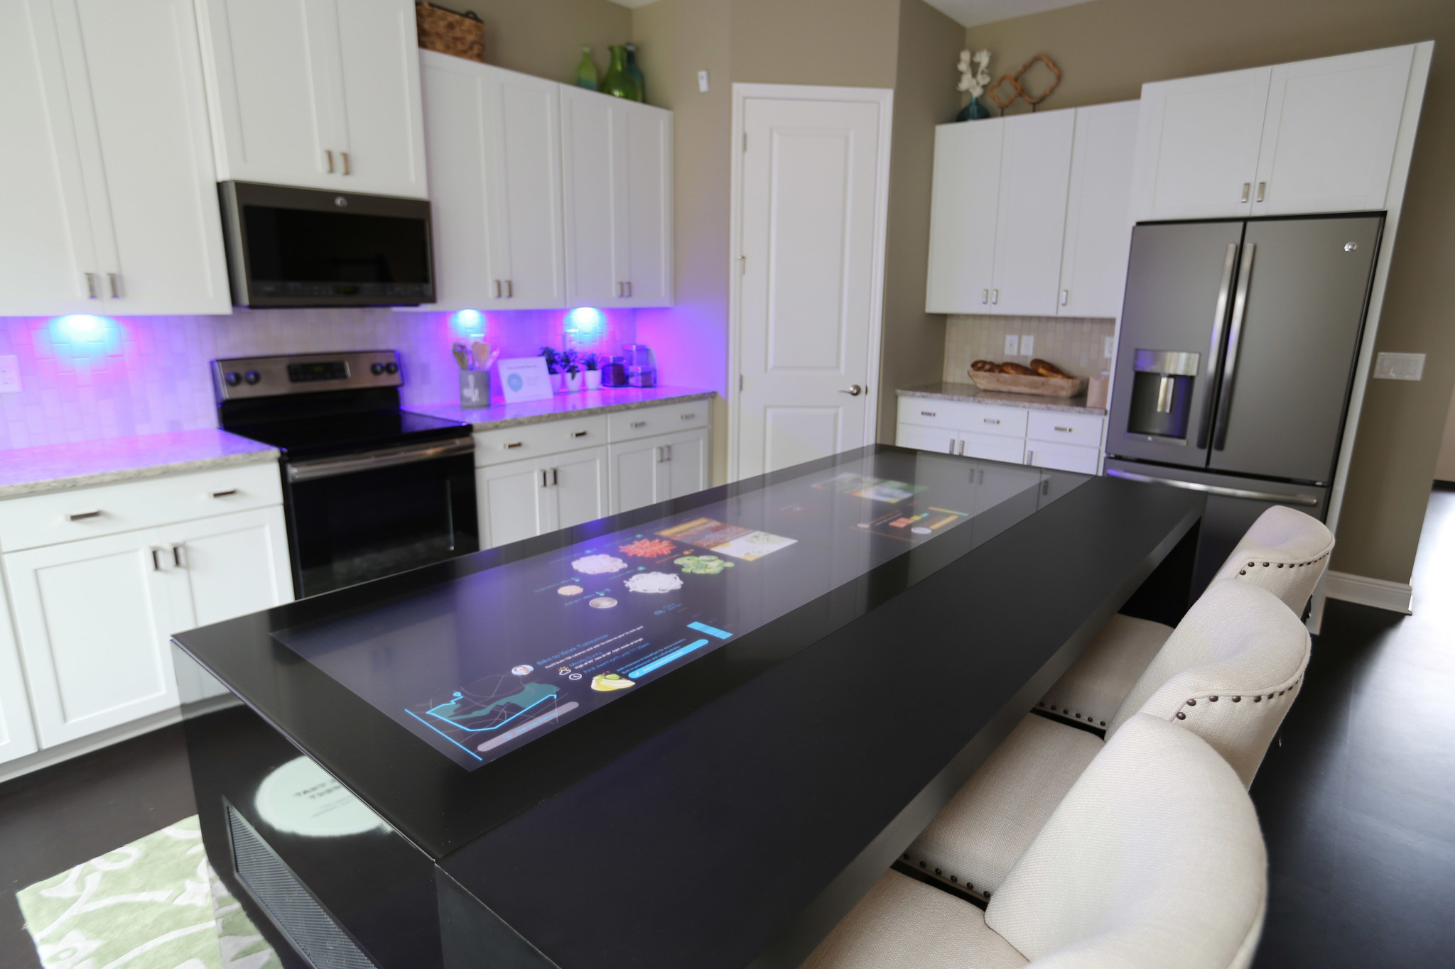
Project 4: Internet of Things for Health and Wellness REU Student: Shanzila Chowdhury Graduate mentor: Michael Eakin Faculty Mentor: Dr. David Metcalf
Week 3 (June 5 –June 9, 2017)
Accomplishments:
Started research on wearables (price, features, accuracy, battery life, water resistance)
Learned about HIMSS, the largest Health IT conference and exhibition in the world
Tour to Lake Nona Medical city, one of the fastest growing community in Orlando, Florida
UCF College of Medicine & Health Sciences Campus, Sanford-Burnham Medical Research Institute, UF Research and Academic Center, Orlando VA(nation's 2nd largest VA), USTA, Guidewell innovation center, and the WHIT Intelligent Home
WHIT(Wellness+Home+Innovation+Technology) Intelligent Home:
Plans for next week:
Continue research on wearables
NSF REU Research Experience on Internet of Things 2017
Notes:
WHIT- It is a first of its kind home designed to activate health solutions and technologies, and research their ability to measurably improve health and well-being. I have included some photos of the WHIT home:
The blue lights radiates UV rays which kill 99.9% germs
The Connected Island from GE appliances lets you plan, schedule, shop, cook, and connect all on one intelligent surface
Besides there is also:
The anti-microbial, mold resistant cork flooring which serves as natural thermal & acoustic insulation
Air scrubbers which tackle all the pollutants: dust, fine particles, molds, pollen, dander & volatile organic compound
Circadian mood lighting engineered to emulate the properties of natural light enhancing sleep quality, energy levels, productivity & overall experience
Voice controlled lighting
Wearables to manage stress
Intelligent mirror prototype that gives health stats and social media feeds
Intelligent toilet self-cleaning prototype that will activate personal health monitoring through home based urinalysis

