Slide 1
Project 3: Development of Wireless Gas Detectors REU Student: Jose Vigil Graduate mentors: Chris Hughes, Xiaochen Wang Faculty Mentor(s): Dr. Hyoung Jin Cho
Week 9 (July 18-22, 2016)
Accomplishments:
-Did more testing with the Device
-Started and almost completed the poster
Issues/problems encountered and solutions (if any):
UV light sensor keeps deteriorating. But the device works.
Plans for next week:
-Finish the poster over the weekend.
-Finish the revision of the report(On hold for the poster)
-Presentations

Slide 2
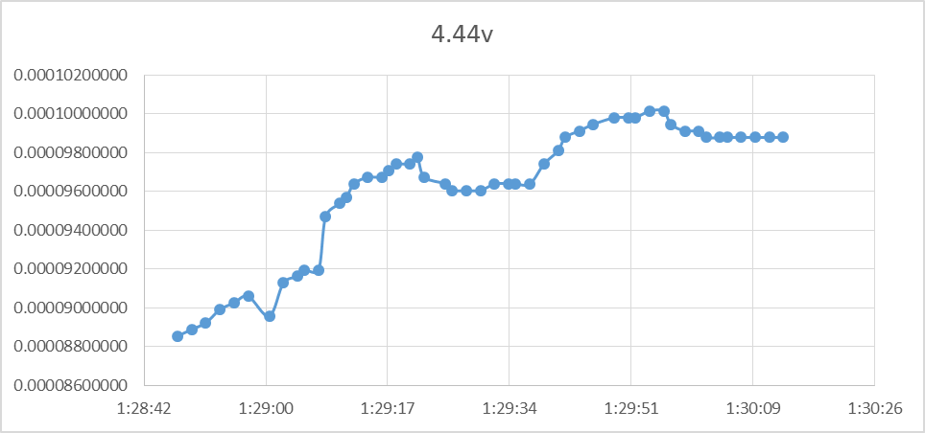
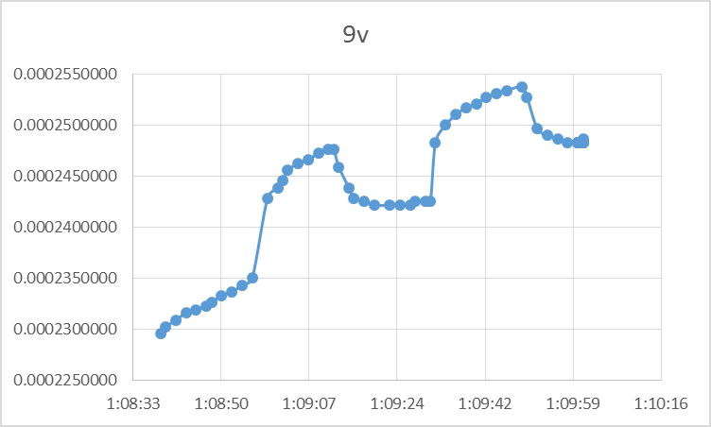
More Testing:
The sensor is still responsive to the exposure of UV light however it does not stabilize fast enough which means the UV sensor is deteriorating.
The monitoring system has no issues. At this point it was even helpful to determine the UV detector was failing.

