Slide 1
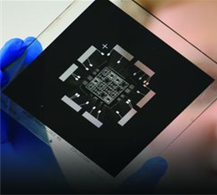
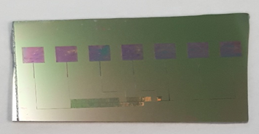
Project 3: Development of Wireless Gas Detectors REU Student: Jose Vigil Graduate mentors: Chris Hughes, Xiaochen Wang Faculty Mentor(s): Dr. Hyoung Jin Cho
Week 8 (July 11-15, 2016)
Accomplishments:
Technical Report
Finished fabrication of UV light Sensor
Testing with Device
Issues/problems encountered and solutions (if any):
Sensor response is not as good as expected(it is a prototype). Solution for future work is to fabricate it through Photolithography Method.
Next Week:
-Review and report
-Start the poster
-Do more testing

Slide 2
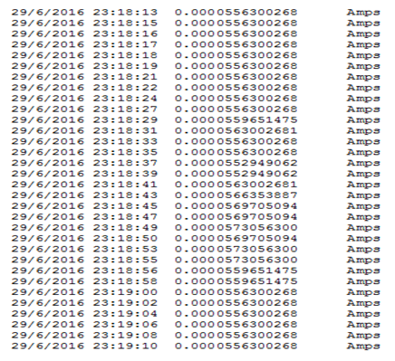
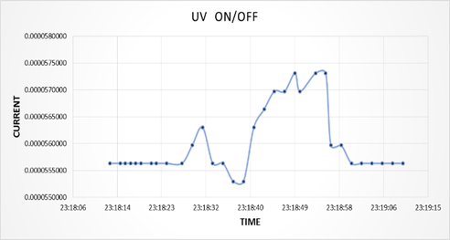
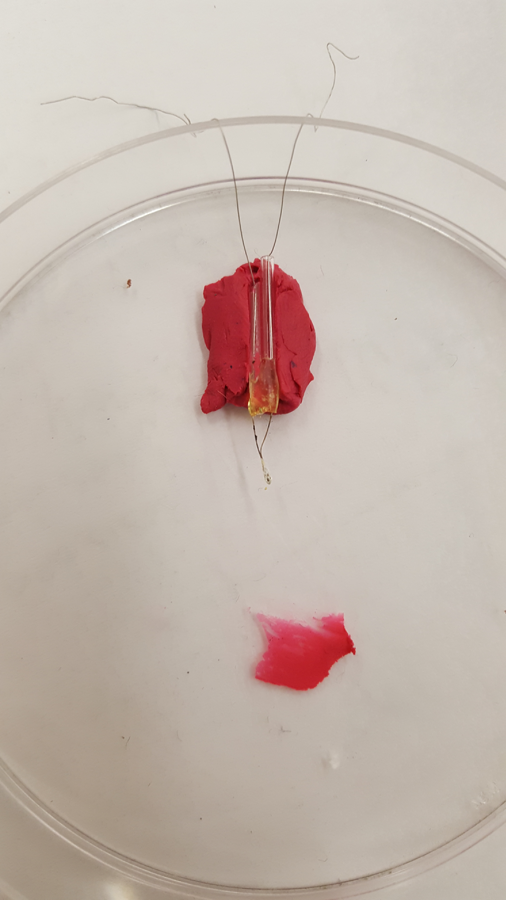
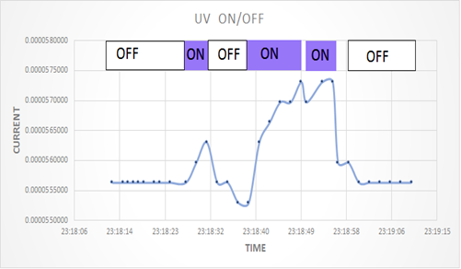
TEST:

