Slide 1
Project 3: Development of Wireless Gas Detectors REU Student: Jose Vigil Graduate mentors: Chris Hughes, Xiaochen Wang Faculty Mentor(s): Dr. Hyoung Jin Cho
Week 5 (June 20 –June 24, 2016)
Accomplishments:
-Solved the digits(decimal places problem for the meter).
-Learned about the fabrication process of the Gas sensor : Hydrogen.
-Started and completed a Remote Access to the Pi.
Issues/problems encountered and solutions (if any):
-Able to access the Raspberry pi desktop and command line.
Main issue: The remote access does not work in campus. Wi-Fi (no access to WPA2 only Guest)
-Mathematica interface may be a solution but there is not much information about interfacing Raspberry pi with Mathematica at the moment.
-Gas sensor is still not ready, electroplating uniformity cannot be reached.

Slide 2
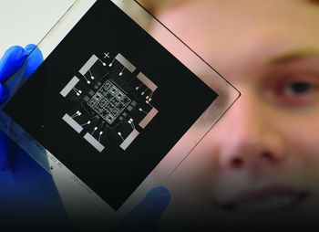
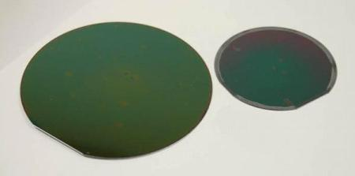
Gas Sensor Fabrication: Hydrogen
Photolithography:
-This process is used to expose the gold layer for the sensor
using UV light.
-Also in this process different element layers are removed
with chemicals.
Electroplating:
Process to deposit CuSo4 (Copper Sulfate) into
the sensor.

Slide 3
Next Week:
-Figure out another way to Remote Control the Raspberry Pi or solve the problem.
-Keep working/helping on the gas sensor fabrication.

