Slide 1
Developing of Wireless Detectors
Jose Vigil Mechanical and Aerospace Engineering New mexico state University Graduate mentors: Chris Hughes, Xiaochen Wang Faculty Mentor: Dr. Hyoung Jin Cho

Slide 2
Goal
The goal is to learn about the fabrication of micro scale sensors and make a cost efficient wireless ammeter to monitor and analyze data from prototype sensors to improve them.
Ammeter
-Wireless Interface
-Record and store readings
-Use for analysis
Raspberry Pi 3

Slide 3
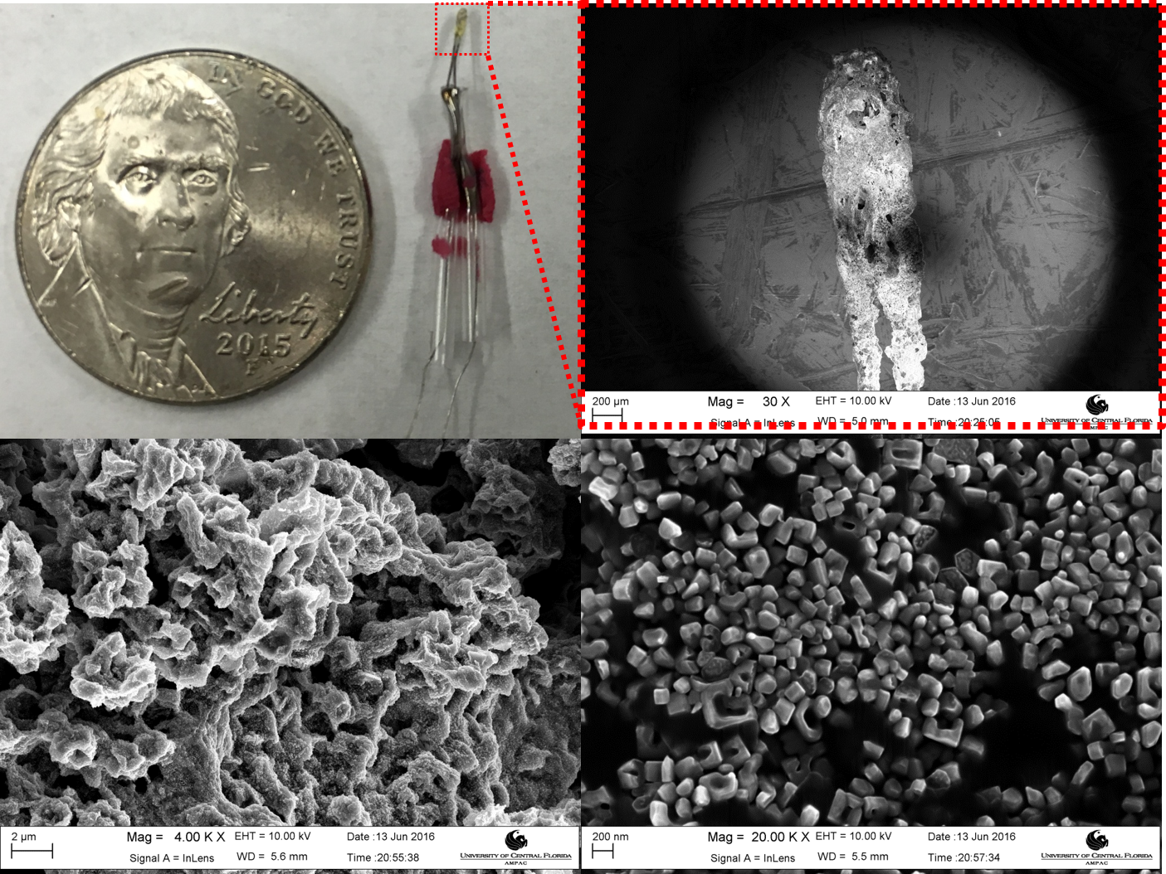
UV Light Sensor
Prototype Fabrication of Zinc Oxide (ZnO)
UV light sensor that reacts as the sensor is exposed to UV rays causing a change in current.

Slide 4
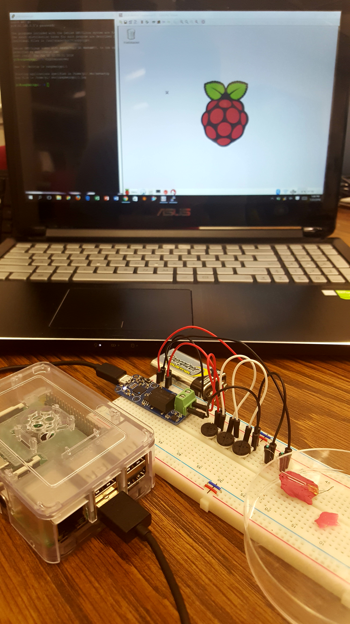
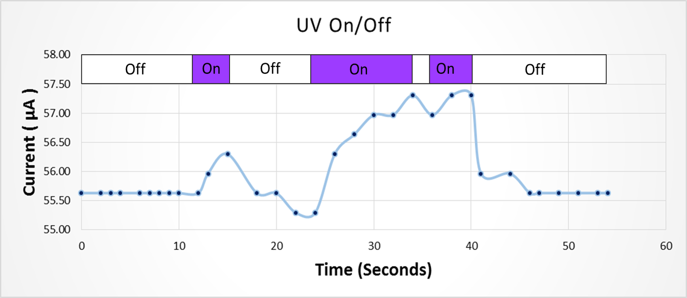
SET UP AND TESTING
Expected peaks and change in current are recorded by the Ammeter when the sensor is exposed to UV light

