Slide 1
Project 2: IoT Device Vulnerabilities and Security REU Student: Bryan Pearson Graduate mentors: Kelvin Ly and Kaveh Shamsi
Faculty Mentor(s): Dr. Jin and Dr. Zhang
Week 2 (May 30 – June 3, 2016)
Accomplishments:
Finished looking through the database
Hacked some IoT devices (router and home network monitor)
Read more articles and a research paper on issues surrounding autonomous driving
Issues/problems encountered and solutions:
Still not sure exactly what to work on for remainder of program
Weekly meeting will address this tonight
Hacking stuff is not always so simple...
Plans for next week:
Begin working on selected project
More hacking!

Slide 2
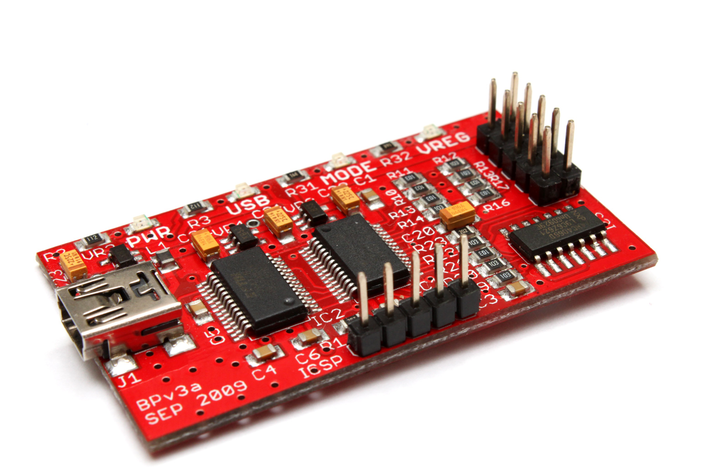
The Hacking Process
Connect computer to Bus Pirate
Will provide communication to the device
Connect the wires of Bus Pirate to device
Serial devices have TX, RX, and Ground pins
Open Bus Pirate in terminal and modify settings
Directly access the root of the device!
The Bus Pirate

