Slide 1
Internet of Hospital Things:
Infrastructure-Less Localization
REU Student: Kiran Pandit Graduate mentors: Myungho Lee Faculty Mentor: Dr. Greg Welch
Notes:
Questions: do I leave mentors who are not on poster on the slides?

Slide 2
Introduction
Problem
Indoor localization important in a hospital setting.
Most methods use complex and expensive RFID systems.
Solution
Goal is to create an infrastructure-less indoor localization system.
Accomplished through:
Ambient method: Machine learning algorithms applied to environmental variables
Phone method

Slide 3
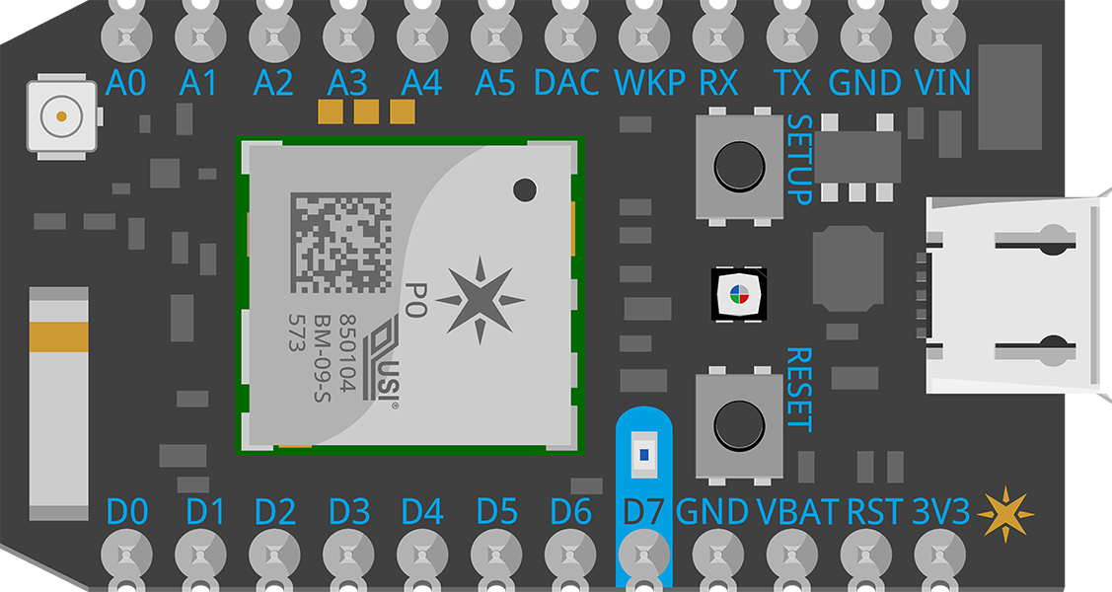
Testing Process
Ambient method: gathered environmental variables (audio features, temperature, light characteristics, and motion) in 3 locations (UCF Student Union, Partnership 3 Lab, and outside of apartment).
Phone method: used different tones to test if device could identify which one was being emitted near it.
Particle Photon microcontroller was used

Slide 4
Results
Ambient method: Audio features were most prominent in correctly predicting the location.
Phone method: Successfully implemented a system to identify DTMF tones through background chatter, which would be used to implement a complete localization system.

