Slide 1
An Exploratory Study on Vagueness in Website Privacy Policies
Nicole Fella
Computer Engineering at Manhattan College
Faculty Advisor: Dr. Fei Liu
Graduate Mentor: Kexin Liao

Slide 2
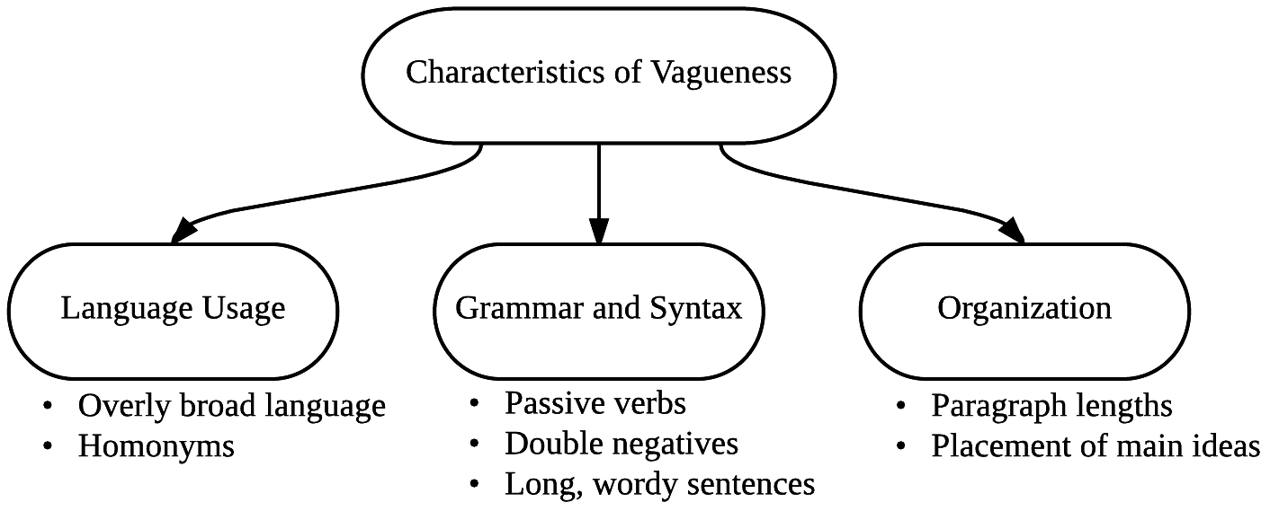
Investigation of Vagueness
Goal: Create a framework to help define and identify characteristics of vagueness to be implemented using a machine learning, natural language processing algorithm for classification
Analyzed legal and linguistic perspectives of vagueness cases
• Indeterminacy • Borderline cases • Linguistic characteristics

Slide 3
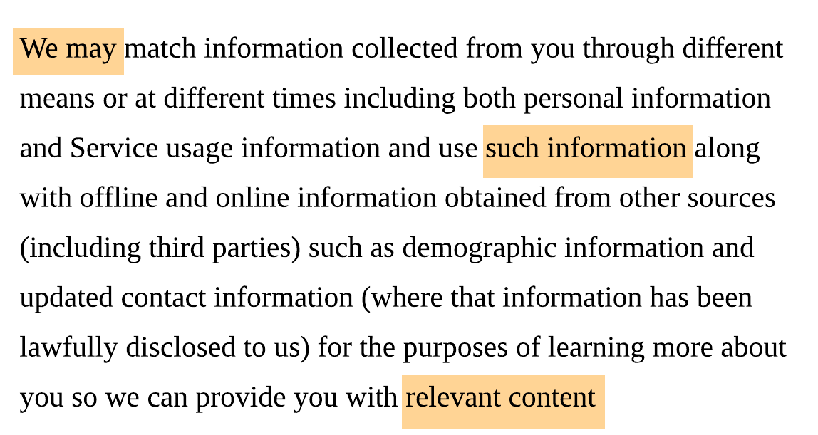
Investigation of Vagueness
Goal: Create a framework to help define and identify characteristics of vagueness to be implemented using a machine learning, natural language processing algorithm for classification
“Unclear” privacy policy excerpt:
Terms similar to those highlighted above extended upon library of vague key words and phrases identified by experts.

