Slide 1
Project 9: Leveraging the Fitbit API to Share Activity Levels with a Trusted Caregiver REU Student: Kim Chen Faculty Mentor(s): Dr. Wisniewski and Dr. Turgut
Week 8 (July 11– July 15, 2016)
Accomplishments:
Meet with advisor to discuss UI Design
Created logo for application
Changed layout for displaying data
Plans for next week:
Development
Implement alert notifications
Start on poster
Start writing paper

Slide 2
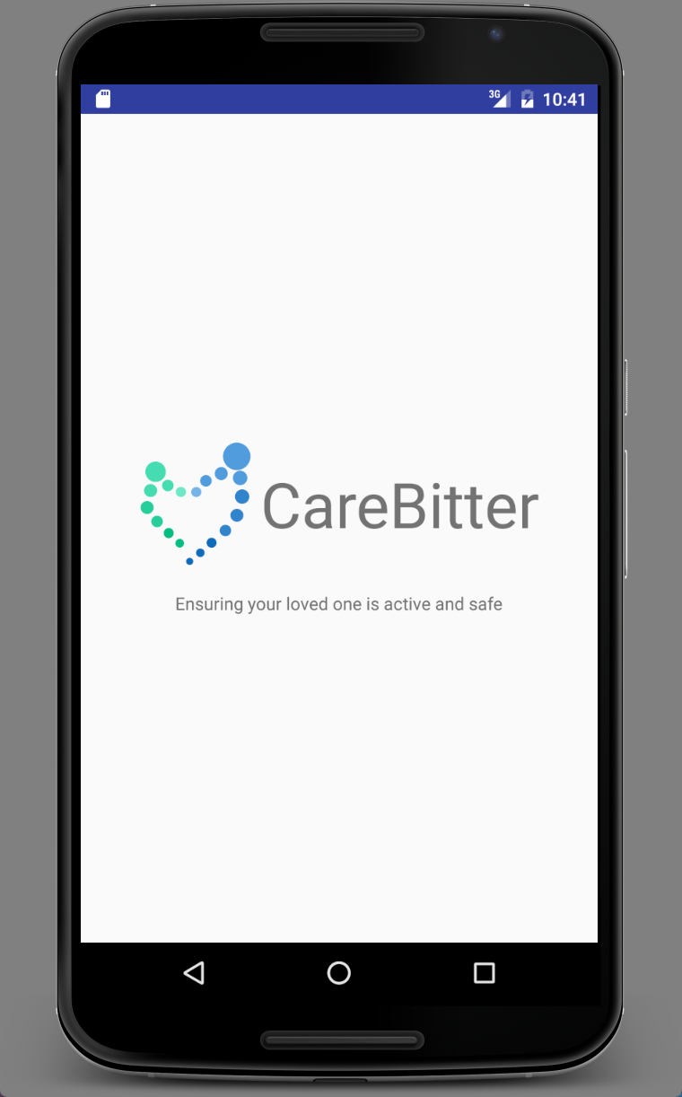
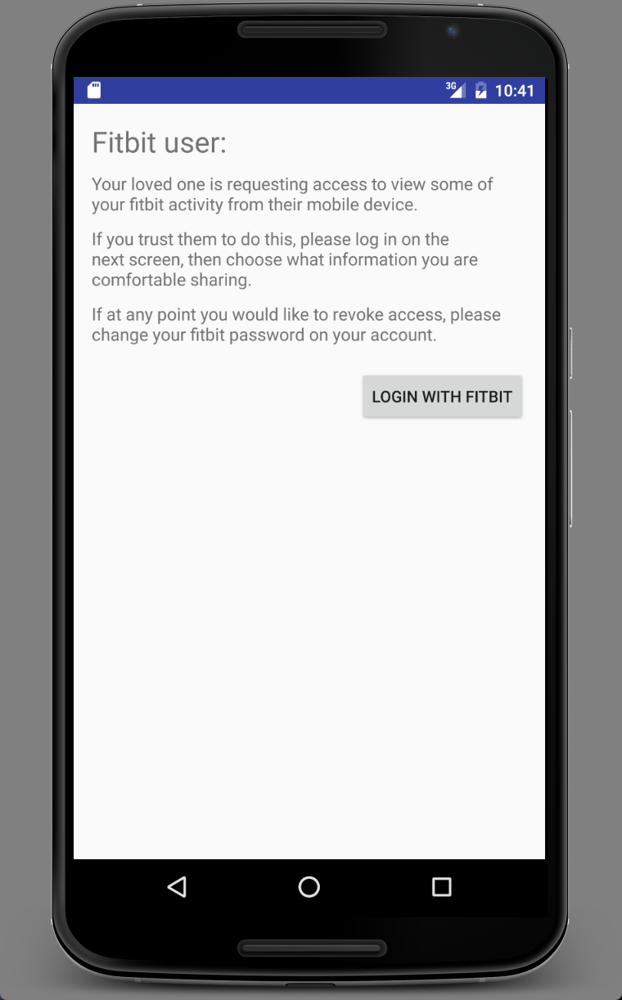
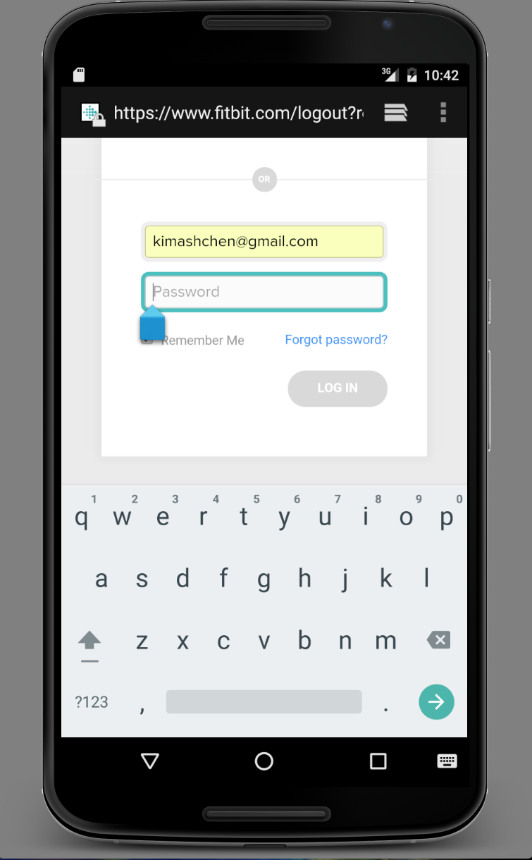
Project 9: Leveraging the Fitbit API to Share Activity Levels with a Trusted Caregiver REU Student: Kim Chen Faculty Mentor(s): Dr. Wisniewski and Dr. Turgut

Slide 3
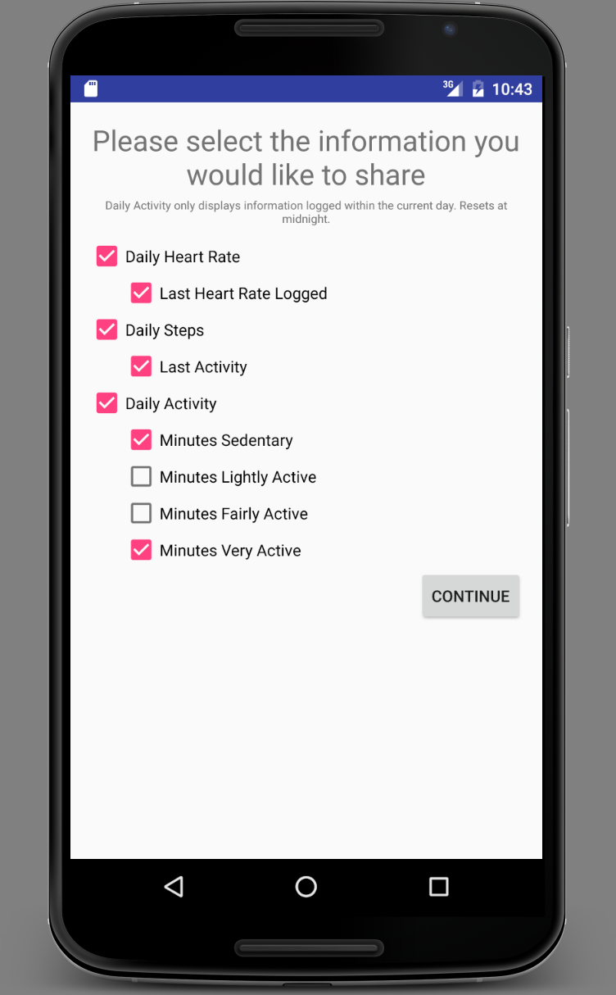
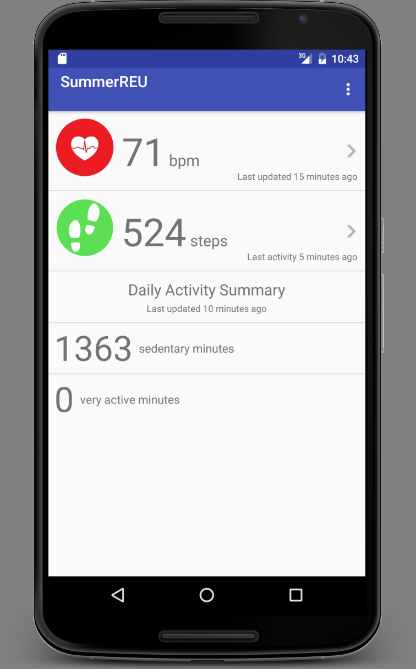
Project 9: Leveraging the Fitbit API to Share Activity Levels with a Trusted Caregiver REU Student: Kim Chen Faculty Mentor(s): Dr. Wisniewski and Dr. Turgut

